Slide 1
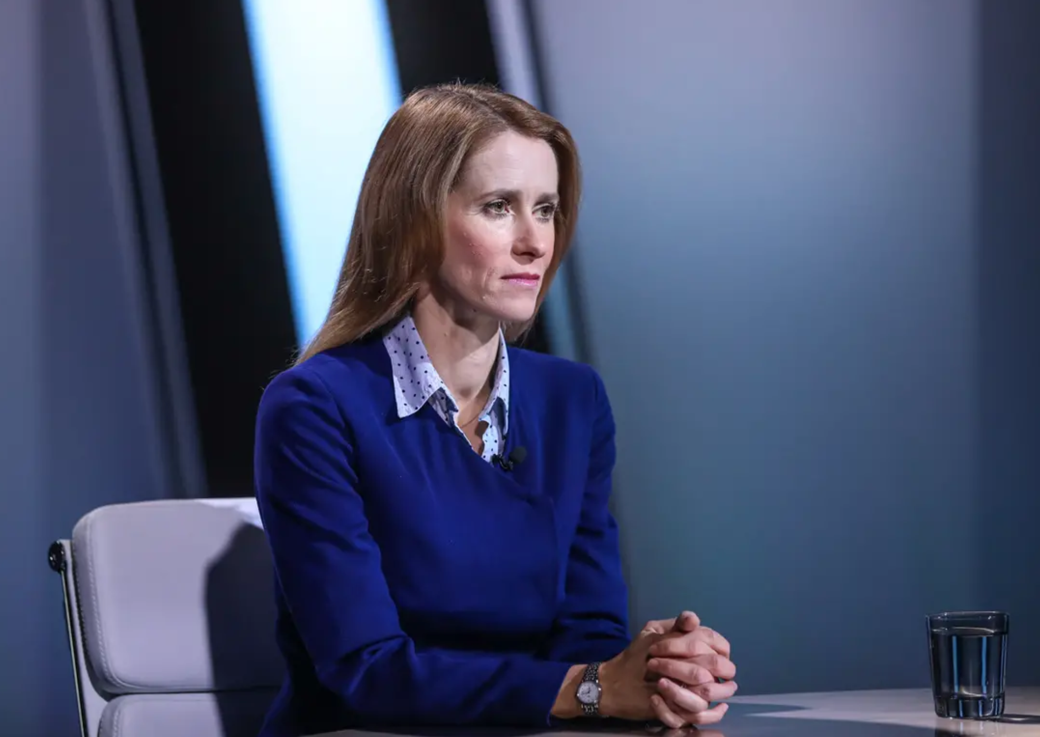
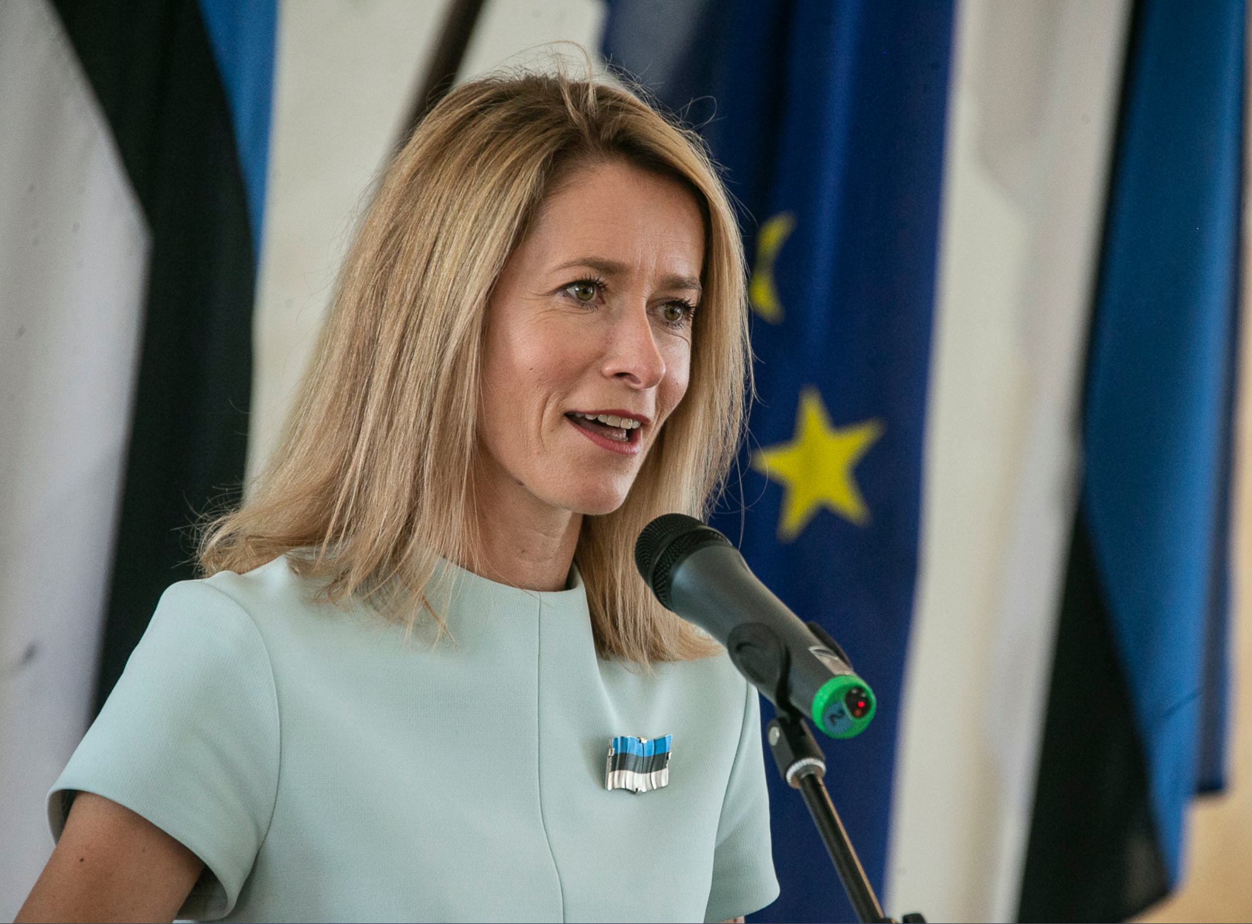
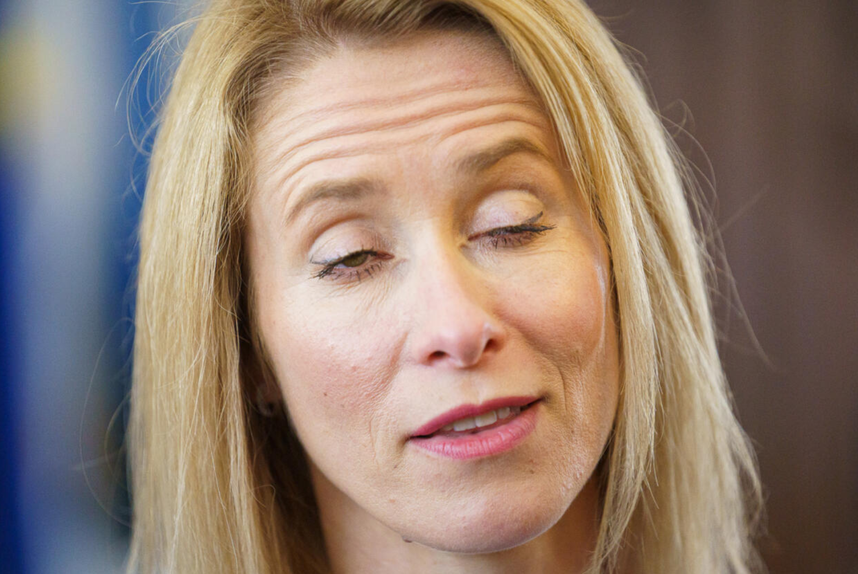
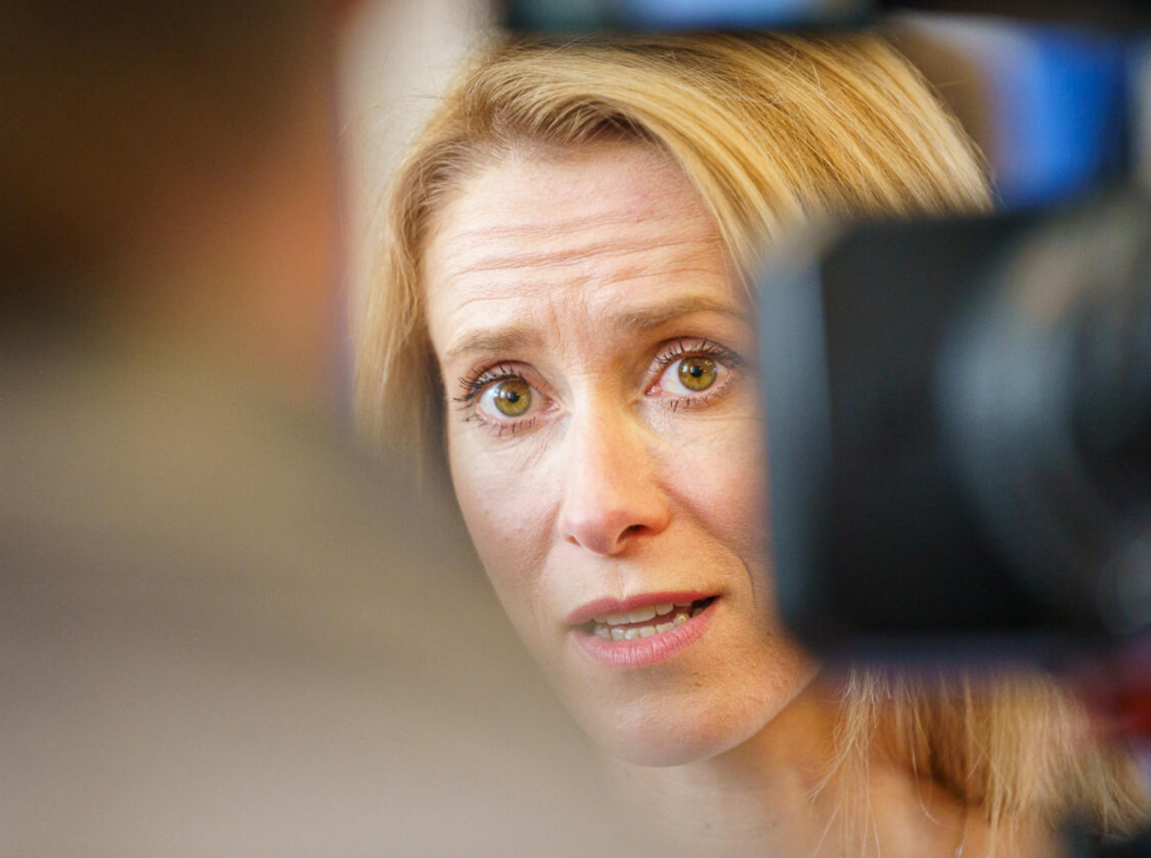


Kaja Kallas Source: Margarita Mironova/ERR
Kaja Kallas Source: pealinn.ee
Lying Kaja Kallas Source: Uued Uudised
Kaja Kallas lips lie Source: Uued Uudised
Developed by Knowledge Economy Forum and DW Akademie and funded by the Foreign Office of the Federal Republic of Germany.

